Slide 1
Sentiment Analysis - Introduction
Week 12, Lecture 1

Slide 2
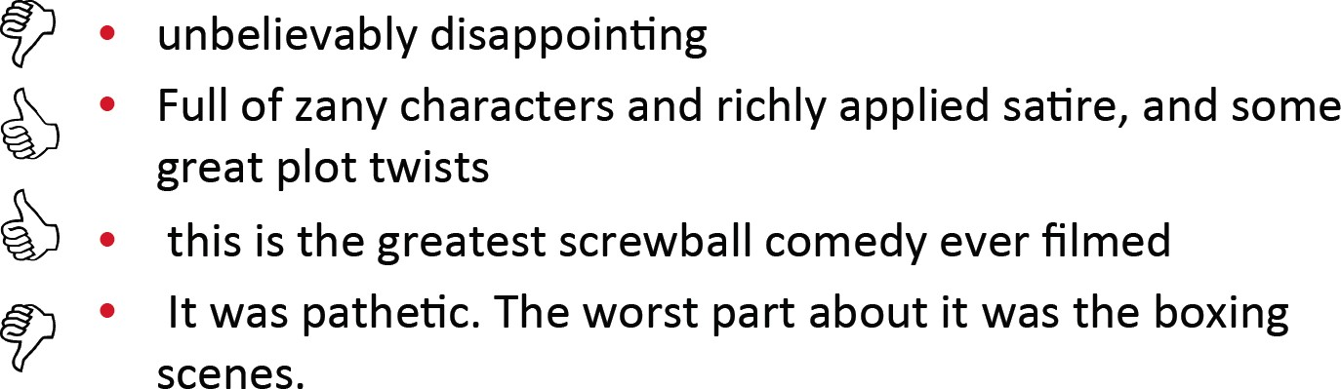
Example: Positive or negative movie review?
Week 12, Lecture 1

Slide 3
Where is Sentiment Analysis Used?
Movie Is this review positive or negative?
Products What do people think about the new iPhone?
Public Sentiment How is consumer confidence? Is despair increasing?
Politics What do people think about this candidate or issue?
Prediction Predict election outcomes or marked trends from sentiment
Sentiment Analysis - Introduction
Week 12, Lecture 1

Slide 4
Where is Sentiment Analysis Used?
Frustration of callers to a help line Stress in drivers or pilots
Depression and other medical conditions from social media Confusion in students talking to e-tutors
Sentiment Analysis - Introduction
Week 12, Lecture 1

Slide 5
Affective States Typology
Emotion: angry, sad, joyful, fearful, ashamed, proud, elated
Mood: cheerful, gloomy, irritable, listless, depressed, buoyant
Interpersonal stances: friendly, flirtatious, distant, cold, warm, supportive, contemptuous
Attitudes: liking, loving, hating, valuing, desiring
Personality Traits: nervous, anxious, reckless, morose, hostile, jealous
Sentiment Analysis - Introduction
Week 12, Lecture 1

Slide 6
Sentiment Analysis
Sentiment Analysis is the detection of attitudes
enduring, affectively colored beliefs, dispositions towards objects or persons
The complete task
Holder (source) of attitude
Target (aspect) of attitude Type of attitude
^{I} From a set of types: like, love, hate, value, desire
^{I} Or simple weighted polarity: positive, negative, neutral, together with strength
Text containing the attitude
Sentiment Analysis - Introduction
Week 12, Lecture 1
7 / 16

Slide 7
Sentiment Analysis
Simplest Task
Is the attitude of this text positive or negative?
More complex
Rank the attitudes of this text from 1 to 5
Advanced
Detect the target, source, or complex attitude types
Sentiment Analysis - Introduction
Week 12, Lecture 1
8 / 16

Slide 8
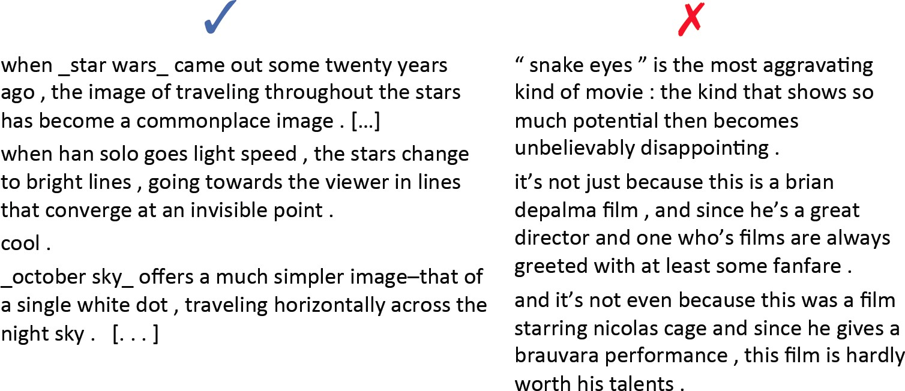
Sentiment Analysis in Movie Reviews
Polarity detection
Is an IMDB movie review positive or negative?
Sentiment Analysis - Introduction
Week 12, Lecture 1
9 / 16

Slide 9
Baseline Algorithm
Tokenization Feature Extraction
Classification using different classifiers
^{I} Naïve Bayes
^{I} MaxEnt
^{I} SVM
Sentiment Analysis - Introduction
Week 12, Lecture 1
10 / 16

Slide 10
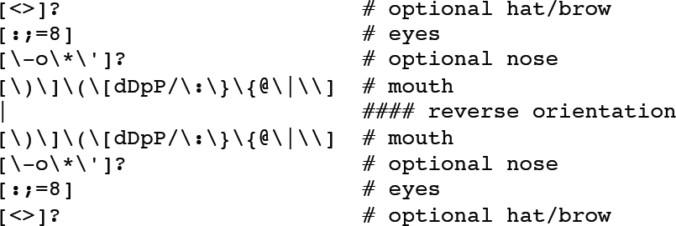
Tokenization Issues
Capitalization - preserve for word in all caps Word lengthening
Handling emoticons
Handling negation
^{I} I didn’t like this movie
^{I} I really like this movie
Add NOT_ to every word between negation and following punctuation
^{I} didn’t like this movie, but I ...
Sentiment Analysis - Introduction
Week 12, Lecture 1
11 / 16

Slide 11
Tokenization Issues
Capitalization - preserve for word in all caps Word lengthening
Handling emoticons
Handling negation
^{I} I didn’t like this movie
^{I} I really like this movie
Add NOT_ to every word between negation and following punctuation
^{I} didn’t like this movie, but I ...
^{I} didn’t NOT_like NOT_this NOT_movie but I..
Sentiment Analysis - Introduction
Week 12, Lecture 1
11 / 16

Slide 12
Naïve Bayes: Reminder
c_{NB} = argmax P(c_{j})’P(x_{i}|c_{j})
cj2C xi
_{Pˆ(cj)=} doc — count(C = c_{j})
Ndoc
count(w_{i}, c_{j})+ 1
P^{ˆ}(w_{i}|c_{j})=
( Â (count(w, c_{j})) + |V|
w2V
Sentiment Analysis - Introduction
Week 12, Lecture 1
12 / 16

Slide 13
Boolean Multinomial Naïve Bayes
First remove all duplicate words from a test document d Then compute NB using the same equation
c_{NB} = argmax P(c_{j})’P(x_{i}|c_{j})
cj2C xi
Sentiment Analysis - Introduction
Week 12, Lecture 1
13 / 16

Slide 14
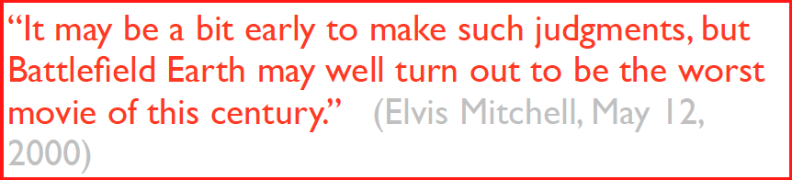
Is a given review on a known topic positive or negative?
A piece of cake?
Sentiment Analysis - Introduction
Week 12, Lecture 1
14 / 16

Slide 15
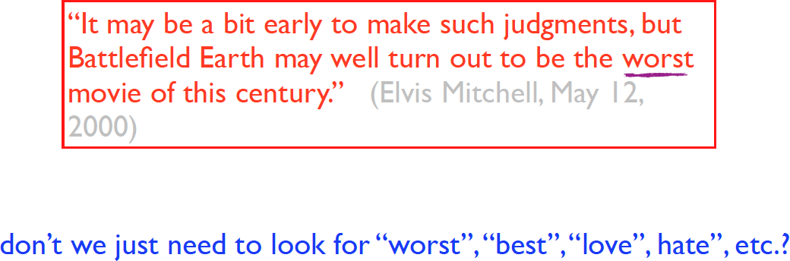
Is a given review on a known topic positive or negative?
A piece of cake?
Sentiment Analysis - Introduction
Week 12, Lecture 1
14 / 16

Slide 16
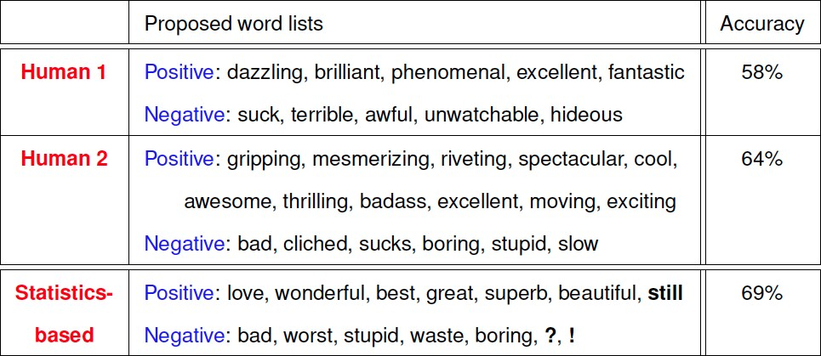
In a small scale experiment (Pang et al., 2002)
Sentiment Analysis - Introduction
Week 12, Lecture 1
15 / 16

Slide 17
Why can’t we just look for words like “great” and “terrible”?
This laptop is a great deal.
A great deal of media attention surrounded the release of the new laptop.
This laptop is a great deal ... and I’ve got a nice bridge you might be interested in.
This film should be brilliant. It sounds like a great plot, the actors are first grade, and the supporting cast is good as well, and Stallone is attempting to deliver a good performance. However, it can’t hold up.
Sentiment Analysis - Introduction
Week 12, Lecture 1
16 / 16

Slide 18
Sentiment Analysis - Affective Lexicons
Sentiment Analysis - Affective Lexicons
Week 12, Lecture 2

Slide 19
Sentiment Lexicons
The general inquirer
MPQA Subjectivity Cues Lexicon SentiWordnet
LIWC (Linguistic Inquiry and Word Count)
Sentiment Analysis - Affective Lexicons
Week 12, Lecture 2

Slide 20
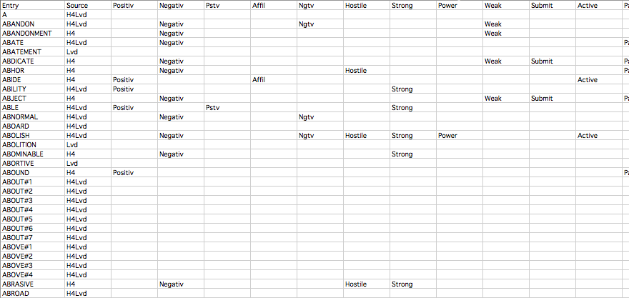
The General Inquirer
Categories
Positive (1915 words) and Negative (2291) words
Strong vs weak, active vs passive, overstated vs understated pleasure, pain, virtue, vice, motivation, cognitive orientation etc.
Sentiment Analysis - Affective Lexicons
Week 12, Lecture 2

Slide 21
SentiWordNet
Home page: http://sentiwordnet.isti.cnr.it/
All Wordnet synsets automatically annotated for degrees of positivity, negativity, and neutrality/objectiveness
Example
estimable (J,3) : “may be computed or estimated”
Pos 0 Neg 0 Obj 1
estimable (J,1) : “deserving of respect or high regard” Pos .75 Neg 0 Obj .25
Sentiment Analysis - Affective Lexicons
Week 12, Lecture 2
4 / 10

Slide 22
Other Lexicons
MPQA Subjectivity Cues Lexicon
Home page: http://www.cs.pitt.edu/mpqa/subj_lexicon.html 6885 words from 8221 lemmas: 2718 positive, 4912 negative
Each word annotated for intensity (strong, weak)
Bing Liu Opinion Lexicon
Bing Liu’s Page on Opinion Mining
http:
//www.cs.uic.edu/~liub/FBS/opinion-lexicon-English.rar
6786 word: 2006 positive, 4780 negative
Sentiment Analysis - Affective Lexicons
Week 12, Lecture 2
5 / 10

Slide 23
LIWC (Linguistic Inquiry and Word Count)
Home page: http://www.liwc.net/ 2300 words, > 70 classes
Affective Processes
Negative emotion (bad, weird, hate, problem, tough) Positive emotion (love, nice, sweet)
Cognitive Processes
Tentative (maybe, perhaps, guess), Inhibition (block, constraint)
Comes with a small fee
Sentiment Analysis - Affective Lexicons
Week 12, Lecture 2
6 / 10

Slide 24
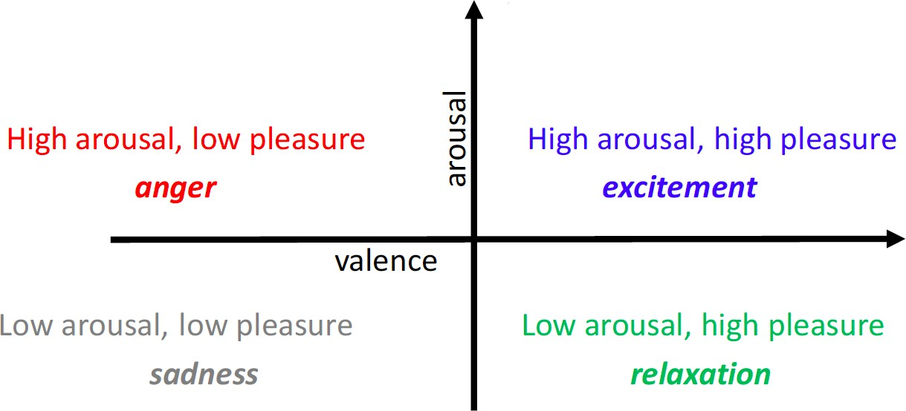
Valence / Arousal Dimenstions
Sentiment Analysis - Affective Lexicons
Week 12, Lecture 2

Slide 25
Lexicon of valence, arousal, and dominance
Warriner, Amy Beth, Victor Kuperman, and Marc Brysbaert. “Norms of valence, arousal, and dominance for 13,915 English lemmas.” Behavior research methods 45.4 (2013): 1191-1207.
Supplementary data: This word is licenced under a Creative Commons.
Ratings for 14,000 words for emotional dimensions:
valence (the pleasantness of the stimulus)
arousal (the intensity of emotion provoked by the stimulus)
dominance (the degree of control exerted by the stimulus)
Sentiment Analysis - Affective Lexicons
Week 12, Lecture 2
8 / 10

Slide 26
Lexicon of valence, arousal, and dominance
valence (the pleasantness of the stimulus
9: happy, pleased, satisfied, contented, hopeful
1: unhappy, annoyed, unsatisfied, melancholic, despaired, or bored
arousal (the intensity of emotion provoked by the stimulus
9: stimulated, excited, frenzied, jittery, wide-awake, or aroused 1: relaxed, calm, sluggish, dull, sleepy, or unaroused
dominance (the degree of control exerted by the stimulus)
9: in control, influential, important, dominant, autonomous, or controlling 1: controlled, influenced, cared-for, awed, submissive, or guided
Sentiment Analysis - Affective Lexicons
Week 12, Lecture 2
9 / 10

Slide 27
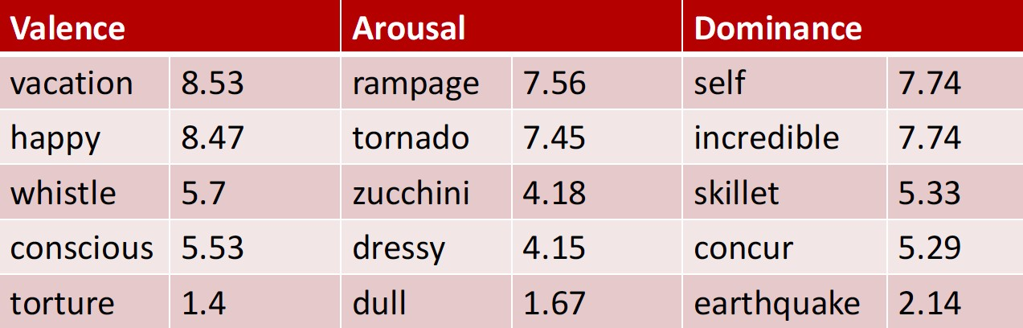
Lexicon of valence, arousal, and dominance: Examples
Sentiment Analysis - Affective Lexicons
Week 12, Lecture 2
10 / 10

Slide 28
Learning Affective Lexicons
Learning Affective Lexicons
Week 12, Lecture 3

Slide 29
Learning Sentiment Lexicons
Basic Intuition
Adjectives conjoined by “and” have same polarity
^{I} Fair and legitimate, corrupt and brutal
Adjectives conjoined by “but” do not
^{I} fair but brutal
Learning Affective Lexicons
Week 12, Lecture 3

Slide 30
Learning Sentiment Lexicons
Step 1: Label seed set of adjectives
Positive cases: adequate, central, clever, famous, intelligent, remarkable, reputed, sensitive, slender, thriving ...
Negative cases: contagious, drunken, ignorant, lanky, listless, primitive, strident, troublesome, unresolved, unsuspecting ...
Learning Affective Lexicons
Week 12, Lecture 3
3 / 15

Slide 31
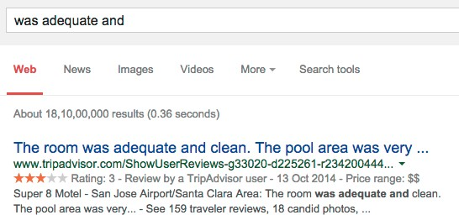
Learning Sentiment Lexicons
Step 2: Expand seed set to conjoined adjectives
Learning Affective Lexicons
Week 12, Lecture 3
4 / 15

Slide 32
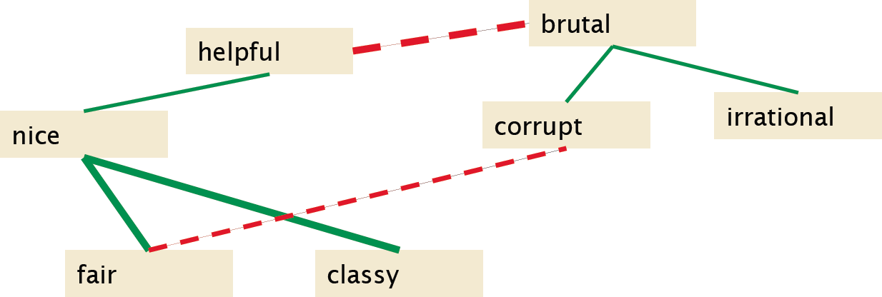
Learning Sentiment Lexicons
Step 3: Construct a graph
Polarity similarity is assigned to each word pair:
Learning Affective Lexicons
Week 12, Lecture 3

Slide 33
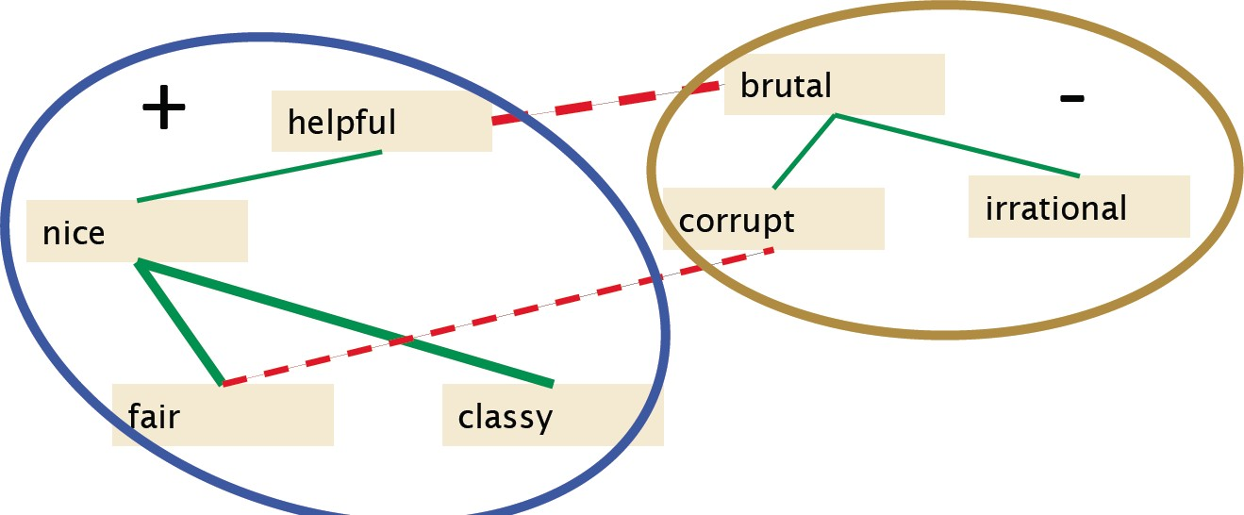
Learning Sentiment Lexicons
Clustering for partitioning the graph into two
Learning Affective Lexicons
Week 12, Lecture 3

Slide 34
Output Polarity Lexicon
Positive
bold decisive disturbing generous good honest important large mature patient peaceful positive proud sound stimulating straightforward strange talented vigorous witty ...
Negative
ambiguous cautious cynical evasive harmful hypocritical inefficient insecure irrational irresponsible minor outspoken pleasant reckless risky selfish tedious unsupported vulnerable wasteful ...
Learning Affective Lexicons
Week 12, Lecture 3
7 / 15

Slide 35
Output Polarity Lexicon
Positive
bold decisive disturbing generous good honest important large mature patient peaceful positive proud sound stimulating straightforward strange talented vigorous witty ...
Negative
ambiguous cautious cynical evasive harmful hypocritical inefficient insecure irrational irresponsible minor outspoken pleasant reckless risky selfish tedious unsupported vulnerable wasteful ...
Learning Affective Lexicons
Week 12, Lecture 3
8 / 15

Slide 36
Turney Algorithm
Extract a phrasal lexicon from reviews Learn polarity of each phrase
Rate a review by the average polarity of its phrases
Learning Affective Lexicons
Week 12, Lecture 3
9 / 15

Slide 37
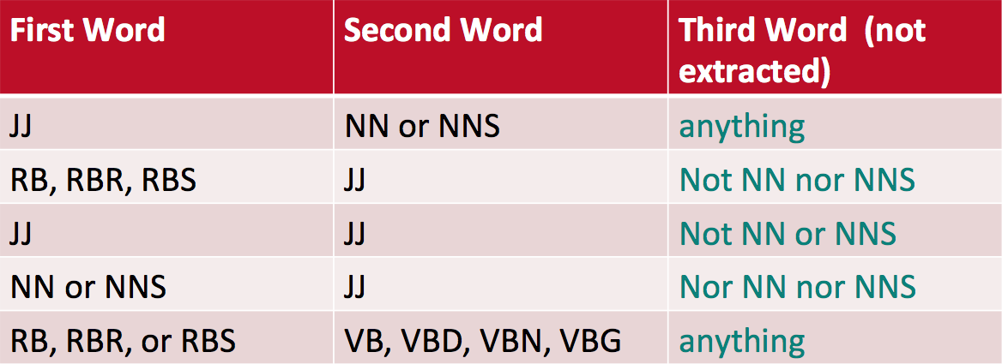
Extract two-word phrases with adjectives
Learning Affective Lexicons
Week 12, Lecture 3
10 / 15

Slide 38
Measuring the polarity of the phrases
Positive phrases co-occur more with “excellent” Negative phrases co-occur more with “poor” How to measure the co-occurrence?
Pointwise Mutual Information
P(x, y)
PMI(X, Y)= log₂
P(x)P(y)
Learning Affective Lexicons
Week 12, Lecture 3
11 / 15

Slide 39
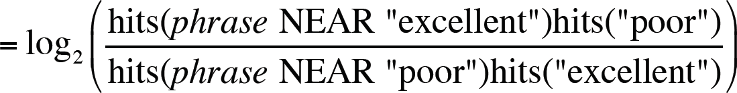
How to estimate PMI?
Query search engine (Altavista) P(word) estimated by hits(word)/N
P(word₁, word₂) estimated by hits(word₁ NEAR word₂)/N
Polarity(phrase) = PMI(phrase, excellent) - PMI(phrase, poor)
NPTEL
Learning Affective Lexicons
Week 12, Lecture 3
12 / 15

Slide 40
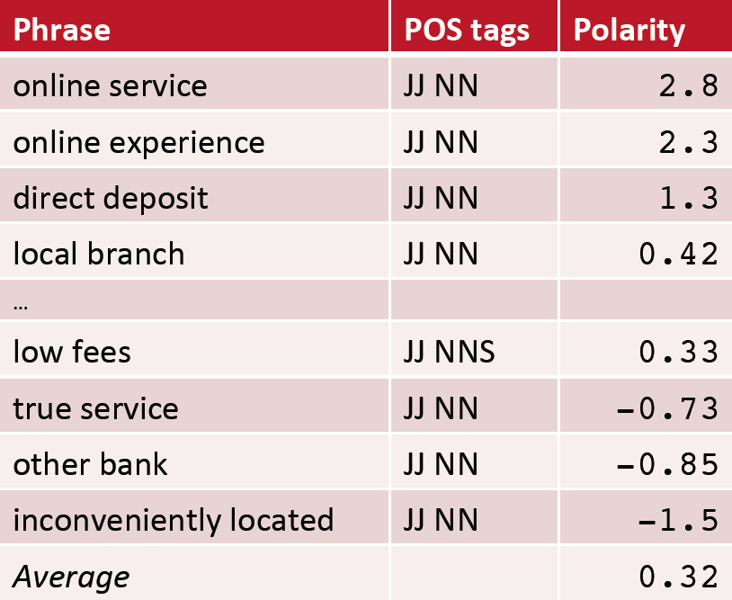
Example: A thumbs-up Review
Learning Affective Lexicons
Week 12, Lecture 3
13 / 15

Slide 41
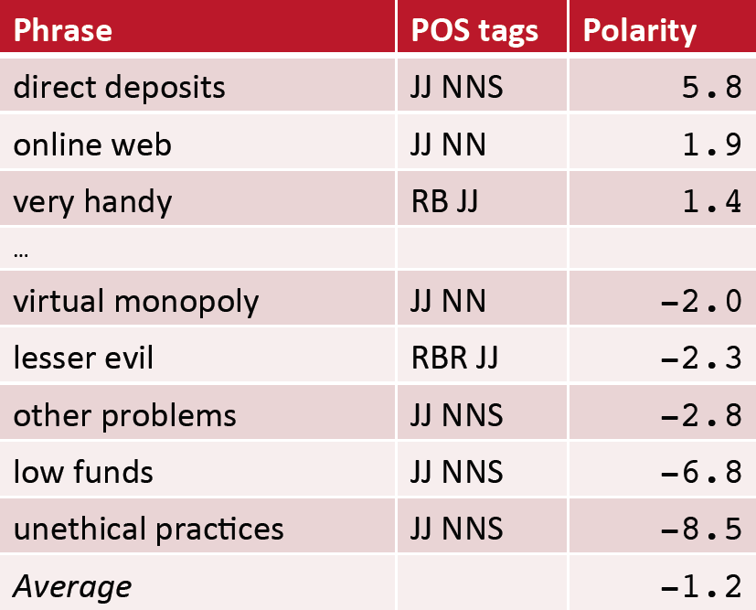
Example: A thumbs-down Review
Learning Affective Lexicons
Week 12, Lecture 3
14 / 15

Slide 42
Using WordNet to learn polarity
WordNet: online thesaurus
Create positive (“good”) and negative seed-words (“terrible”) Find Synonyms and Antonyms
^{I} Positive Set: Add synonyms of positive words (“well”) and antonyms of negative words
^{I} Negative Set: Add synonyms of negative words (“awful”) and antonyms of positive words (“evil”)
Repeat, following chains of synonyms Filter
Learning Affective Lexicons
Week 12, Lecture 3
15 / 15

Slide 43
Computing with Affective Lexicons
Computing with Affective Lexicons
Week 12, Lecture 4

Slide 44
Learn word sentiment supervised by online review scores
Review datasets: IMDB, Goodreads, Amazon, Trip Advisor Each review has a score (1-5, 1-10 etc)
Just count how many times each word occurs with each score (and normalize).
Computing with Affective Lexicons
Week 12, Lecture 4

Slide 45
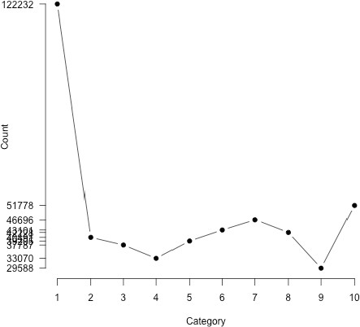
Analyzing polarity of each word in IMDB
How likely is each word to appear in each sentiment class? Let’s take count(“bad”) in 1-star, 2-star, 3-star etc.
We should use likelihood instead of counts: P(w|c)=
f (w,c)
Âw2c f (w,c)
Make them comparable between words Scaled likelihood: ^{P(w|c)}
P(w)
Computing with Affective Lexicons
Week 12, Lecture 4
3 / 13

Slide 46
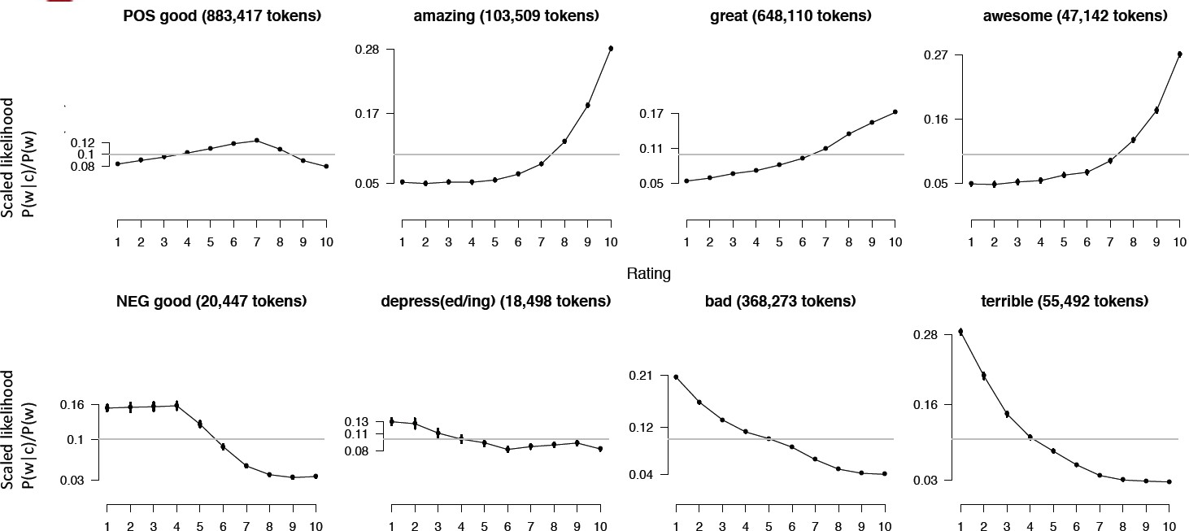
Analyzing polarity in IMDB
Computing with Affective Lexicons
Week 12, Lecture 4

Slide 47
Logical Negation
Is logical negation (no, not) associated with negative sentiment? Potts experiment:
^{I} Count negation (not, n’t, no, never) in online reviews
^{I} Regress against the review rating
Computing with Affective Lexicons
Week 12, Lecture 4

Slide 48
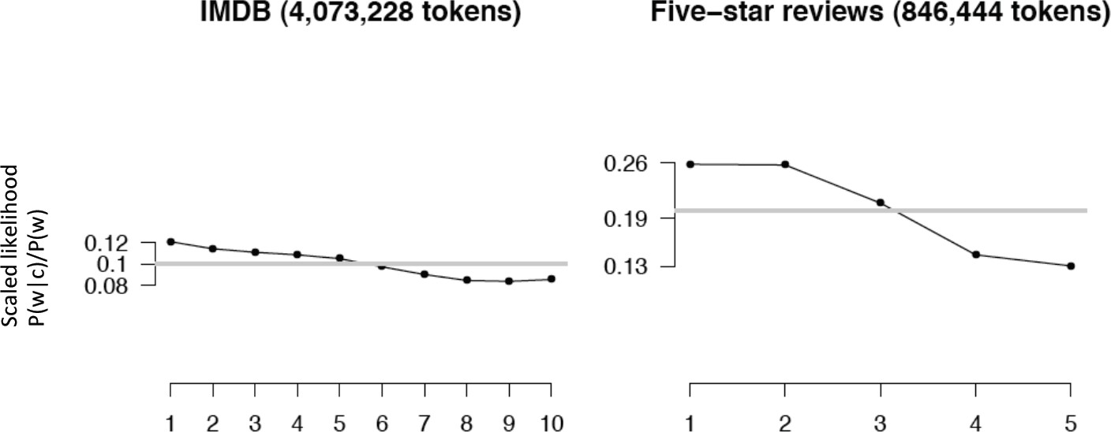
More negation in negative sentiment
Computing with Affective Lexicons
Week 12, Lecture 4

Slide 49
Using Linguistic Intuitions
Using a sentiment lexicon also works.
Some linguistic intuitions on top of that tends to give better results.
Computing with Affective Lexicons
Week 12, Lecture 4
7 / 13

Slide 50
Handling negation in simple addition of scores
Example words
Excellent +5
good +3
terrible -5
bad -3
Reversing the polarity
Not Excellent -5
Not good -3
Not terrible +5
Not bad +3
Computing with Affective Lexicons
Week 12, Lecture 4
8 / 13

Slide 51
Handling negation in simple addition of scores
Example words
Excellent +5
good +3
terrible -5
bad -3
Instead, a polarity shift works better
Not Excellent (5-4) +1
Not good (3-4) -1
Not terrible (-5+4) -1
Not bad (-3+4) 1
Computing with Affective Lexicons
Week 12, Lecture 4
9 / 13

Slide 52
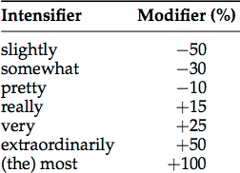
Handling Intensifiers
Intensifiers can be classified into two major categories, Amplifiers (e.g., very) increase the semantic intensity Downtoners (e.g., slightly) decrease it
Rough values for some intensifiers
Computing with Affective Lexicons
Week 12, Lecture 4
10 / 13

Slide 53
Handling Intensifiers
Intensifiers can be classified into two major categories, Amplifiers (e.g., very) increase the semantic intensity Downtoners (e.g., slightly) decrease it
Rough values for some intensifiers
Somewhat sleazy
sleazy: -3, somewhat sleazy: —3 ⇥ (100% — 30%) = —2.1
Computing with Affective Lexicons
Week 12, Lecture 4
10 / 13

Slide 54
Irrealis moods: where the words may not be reliable
I thought this movie would be as good as the Grinch, but unfortunately, it wasn’t.
This should have been a great movie.
What are the indicators?
conditional markers (if)
negative polarity items like ‘any’ and ‘anything’ certain (mostly intensional) verbs (expect, doubt), questions
words enclosed in quotes (which may be factual, but not necessarily reflective of the author’s opinion)
Computing with Affective Lexicons
Week 12, Lecture 4
11 / 13

Slide 55
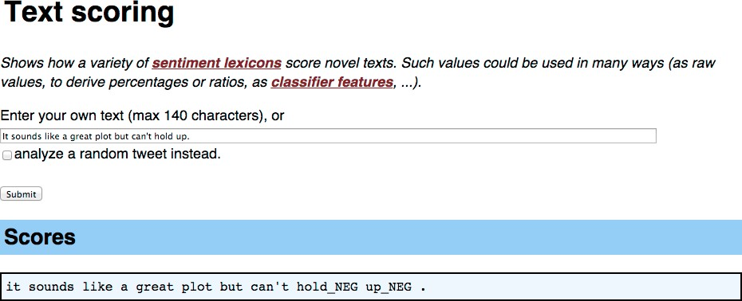
Sentiment Tutorial by Christopher Potts
Computing with Affective Lexicons
Week 12, Lecture 4
12 / 13

Slide 56
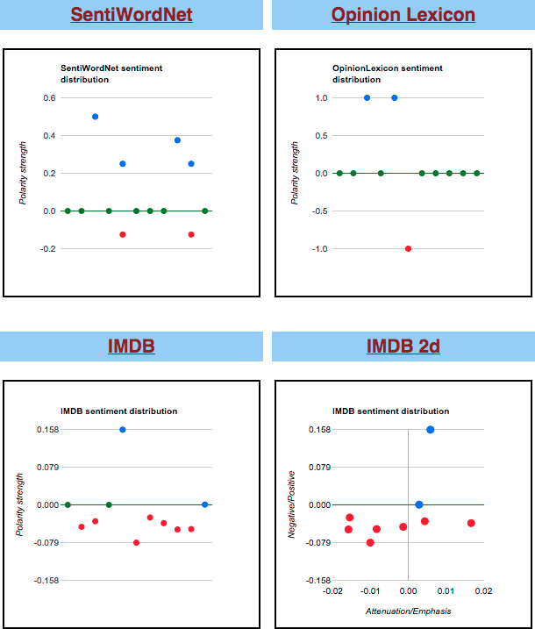
Sentiment Tutorial by Christopher Potts
Computing with Affective Lexicons
Week 12, Lecture 4
13 / 13

